Slide 1
SkillsCommons Support Services Center: Preparing and Sharing Your TAACCCT Deliverables
Tips for Ensuring Submission of Your Deliverables to SkillsCommons.org Go Well

Slide 2
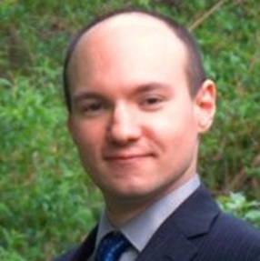
Moderator
Evan Burke
Federal Project Officer for SkillsCommons
Evaluation Coordinator, TAACCCT Grant Program, US Department of Labor

Slide 3
Policy on submitting grant-funded deliverables
Policy on submitting grant-funded deliverables:
Grant-funded deliverables must be uploaded by the end of grantees’ period of performance, September 30th, at the latest.
DOL is tracking submission of deliverables from now until closeout. Your FPO will follow up with you if you have not yet created an account to begin submission.
We strongly advise Round 3 grantees to start the submission process now, well in advance of the September 30th deadline. We expect all grantees to have created their accounts on SkillsCommons to begin the submission process, but this is only the first step.
To start uploading, create your SkillsCommons account at: http://support.skillscommons.org/home/contribute-manage/
If you have any questions:
For policy questions: taaccct@dol.gov (and copy your FPO)
For questions about using SkillsCommons: support@skillscommons.org

Slide 4
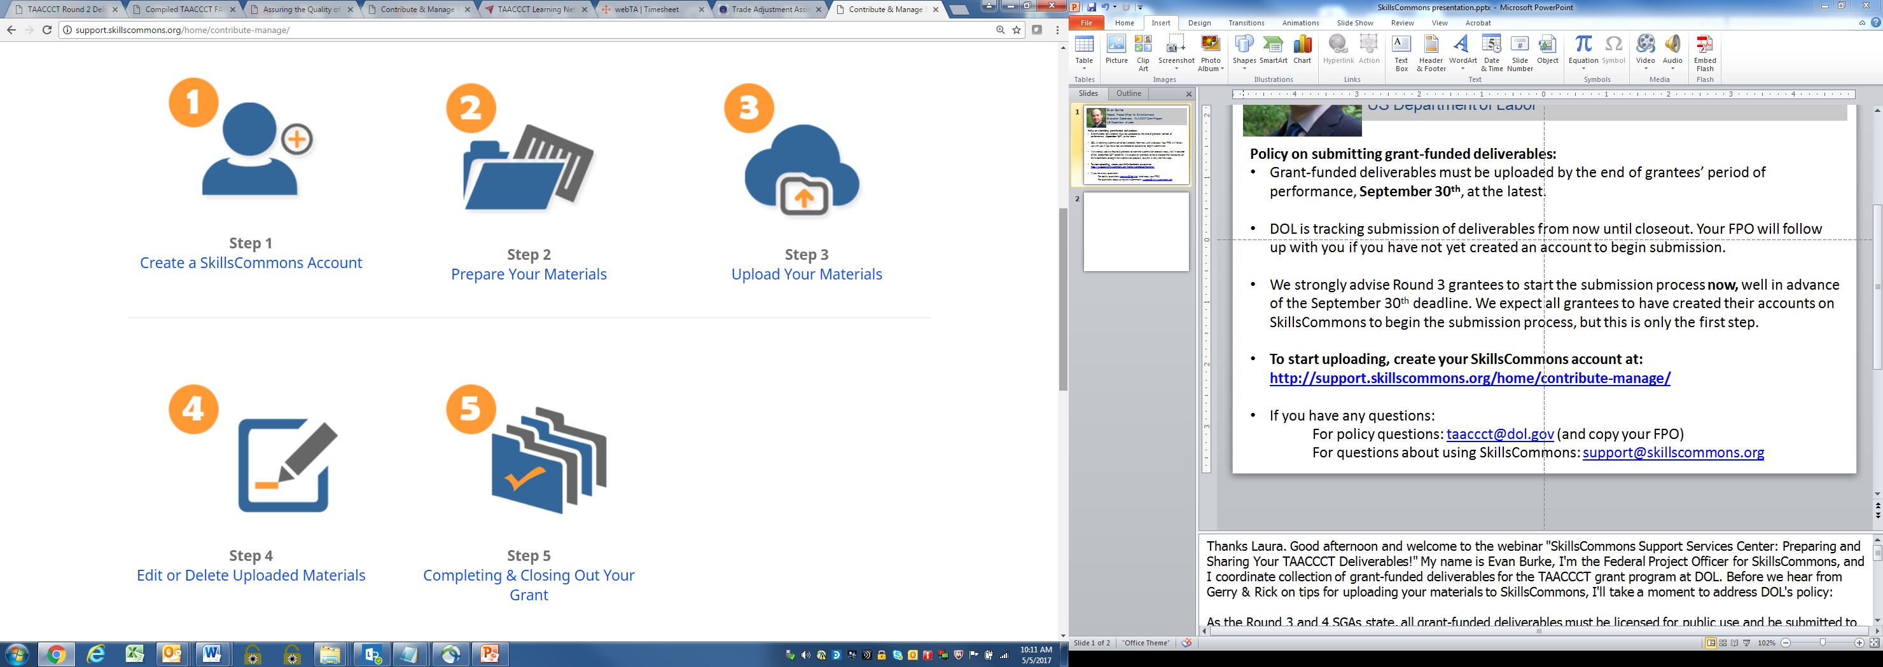
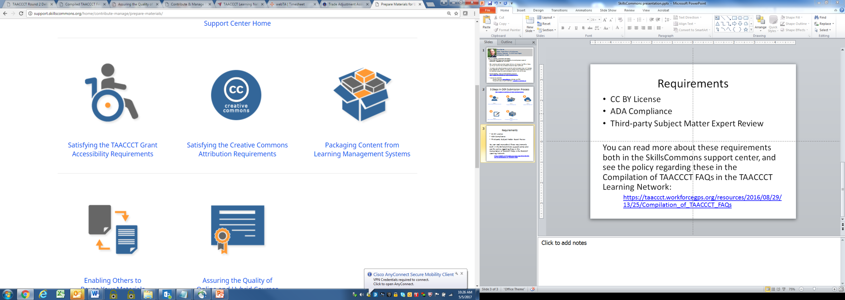


Steps
5 Steps in OER Submission Process
5 Steps in OER Submission Process
http://support.skillscommons.org/home/contribute-manage/
Requirements
Create a SkillsCommons Account
CC BY License
ADA Compliance
Subject Matter
Expert Review
Prepare your materials
Upload your Materials
Edit Uploaded Materials
(if necessary)
Closing out your Grant

Slide 5
More Information
For more information on the OER Submission Process:
http://support.skillscommons.org/home/contribute-manage/
For more information on deliverables policy, please see the Compilation of TAACCCT FAQs resource on the TAACCCT Learning Network:
https://taaccct.workforcegps.org/resources/2016/08/29/13/25/Compilation_of_TAACCCT_FAQs

Slide 6
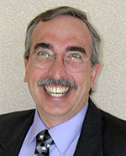
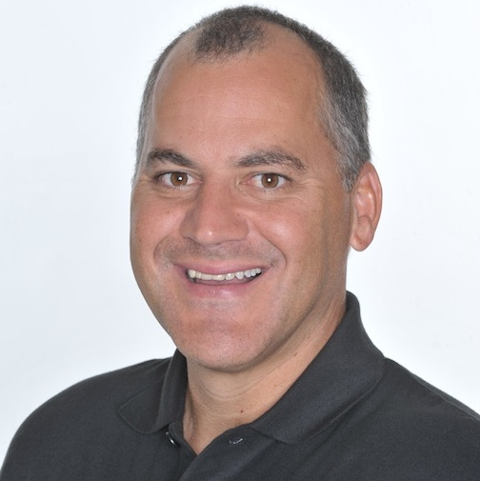
Presenters
Gerry Hanley
Director, Skillscommons.org
Rick Lumadue
Associate Director, Skillscommons.org

Slide 7
Agenda
Review SGA Requirement for
  CC-BY Licensing
  DOL Disclaimer Statement
  Accessibility
  Quality Assurance: Subject Matter Expert Review, UDL, Online/Hybrid
  Grant Deliverables
Tools and Guidelines to Help Your Move Go Well
Moving Your Home: Metaphor for Uploading to SkillsCommons
Demonstrate the submission process of material to SkillsCommons.org
  Learning Resources Collection
  Program Support Materials Collection

Slide 8
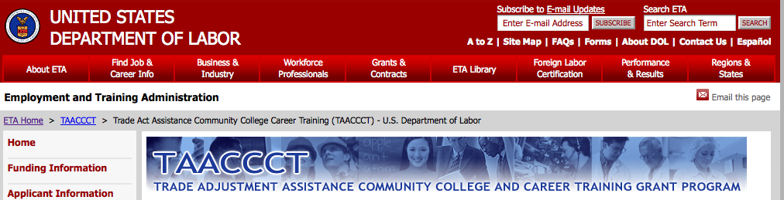
CC-BY Licensing
What is the CC BY requirement in the TAACCCT grant?

Slide 9

CC-BY Licensing
1.1 Creative Commons License
“To ensure that the Federal investment of these funds has as broad an impact as possible and to encourage innovation in the development of new learning materials, as a condition of the receipt of a TAACCCT grant, the grantee will be required to license to the public all work (except for computer software source code, discussed below) created with the support of the grant under a Creative Commons Attribution 4.0 (CC BY) license. Work that must be licensed under the CC BY includes both new content created with the grant funds and modifications made to pre-existing, grantee-owned content using grant funds.”
Retrieved 12/5/2014 from: http://www.doleta.gov/grants/pdf/SGA-DFA-PY-13-10.pdf. pg. 37.

Slide 10
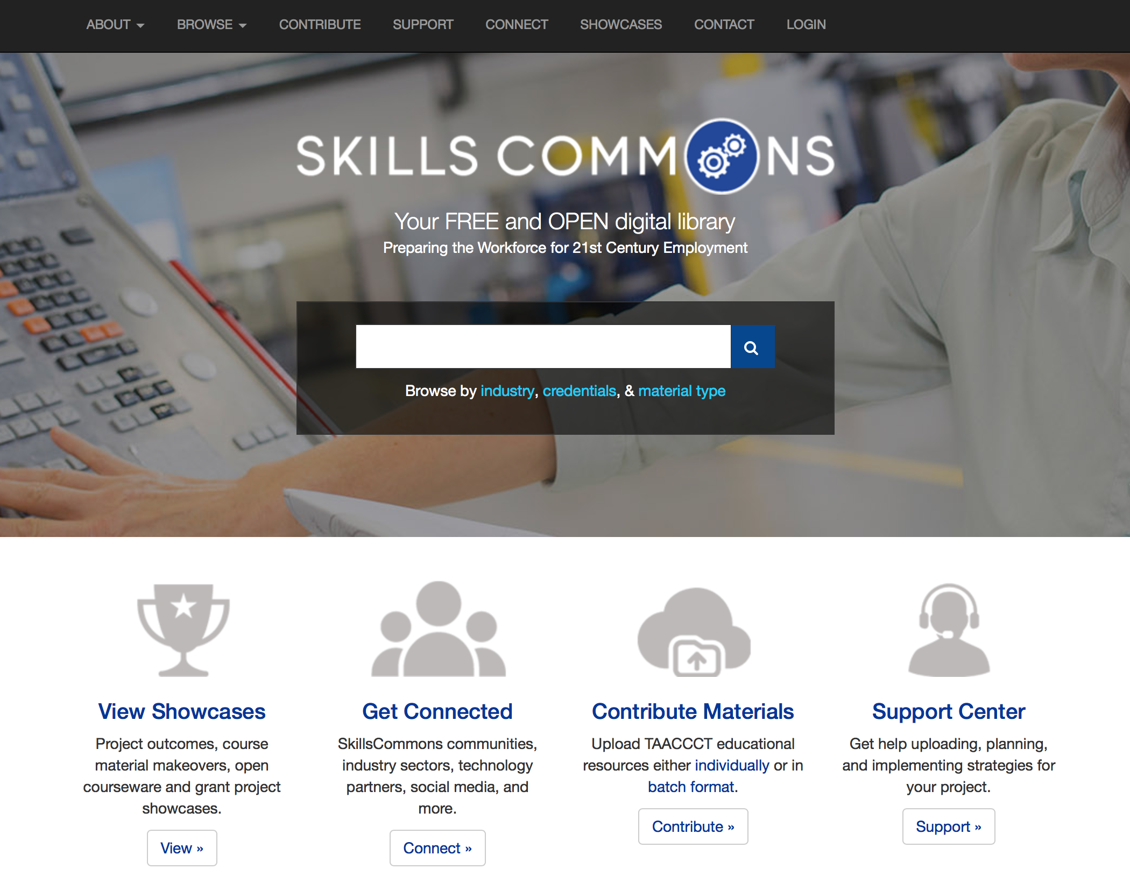
Support Center: Help With CC-BY Licensing

Slide 11
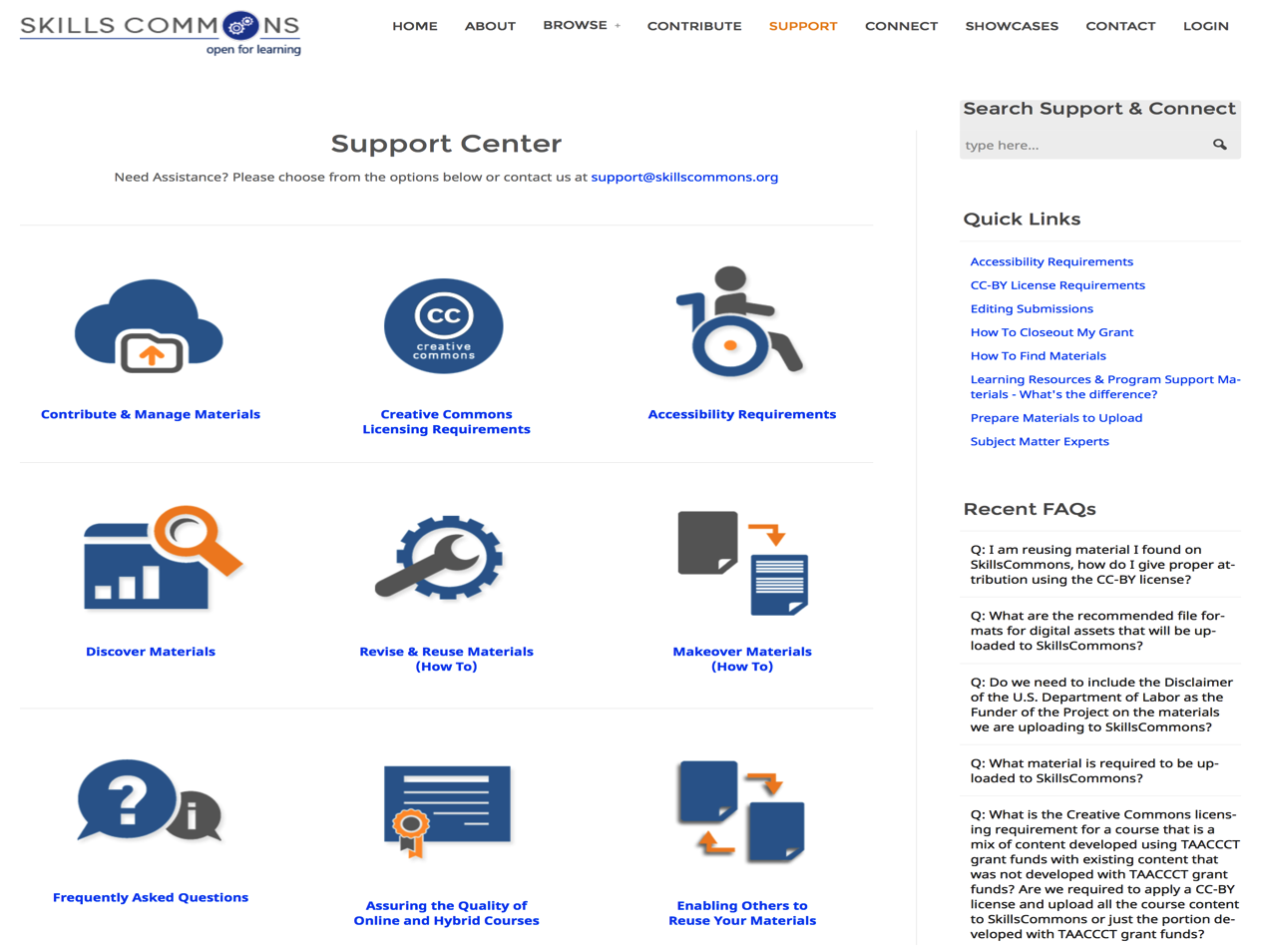
Creative Commons License
“The purpose of the CC BY licensing requirement is to ensure that materials developed with funds provided by these grants result in work that can be freely reused and improved by others.”

Slide 12
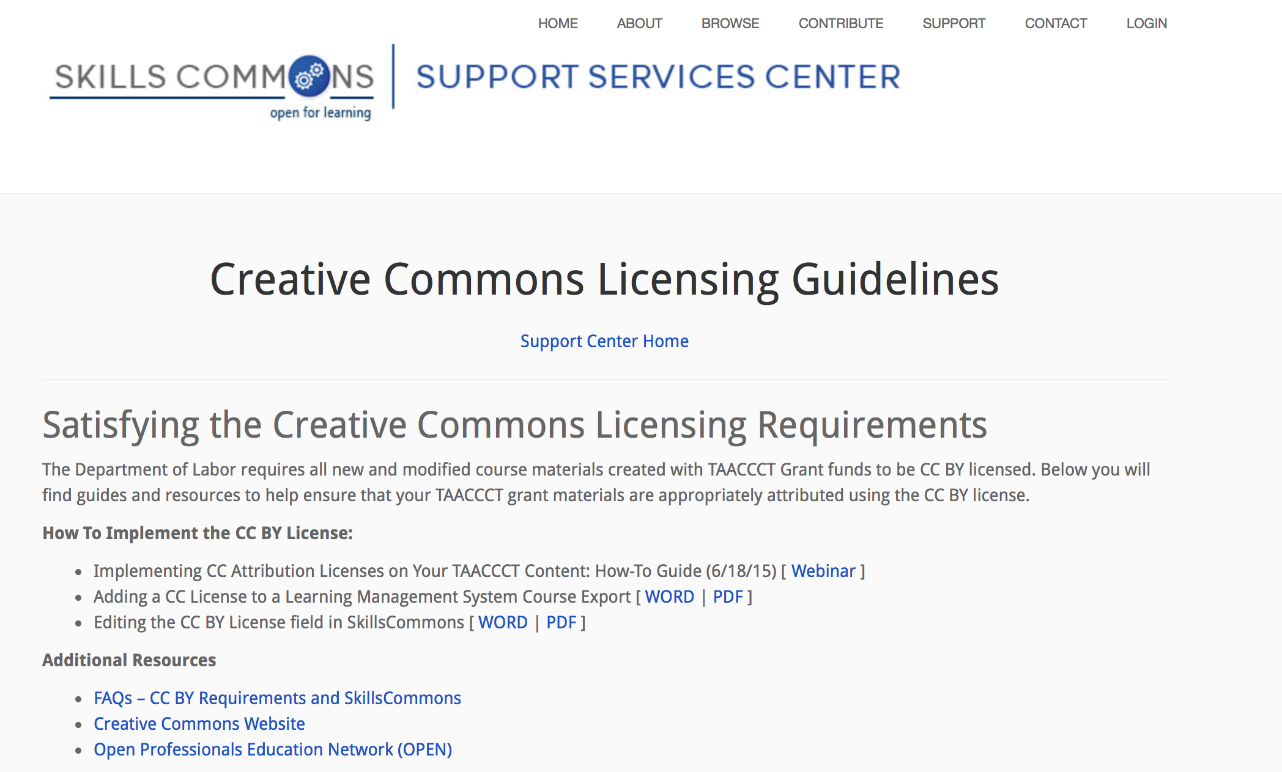
CC-BY Licensing – Guidelines

Slide 13
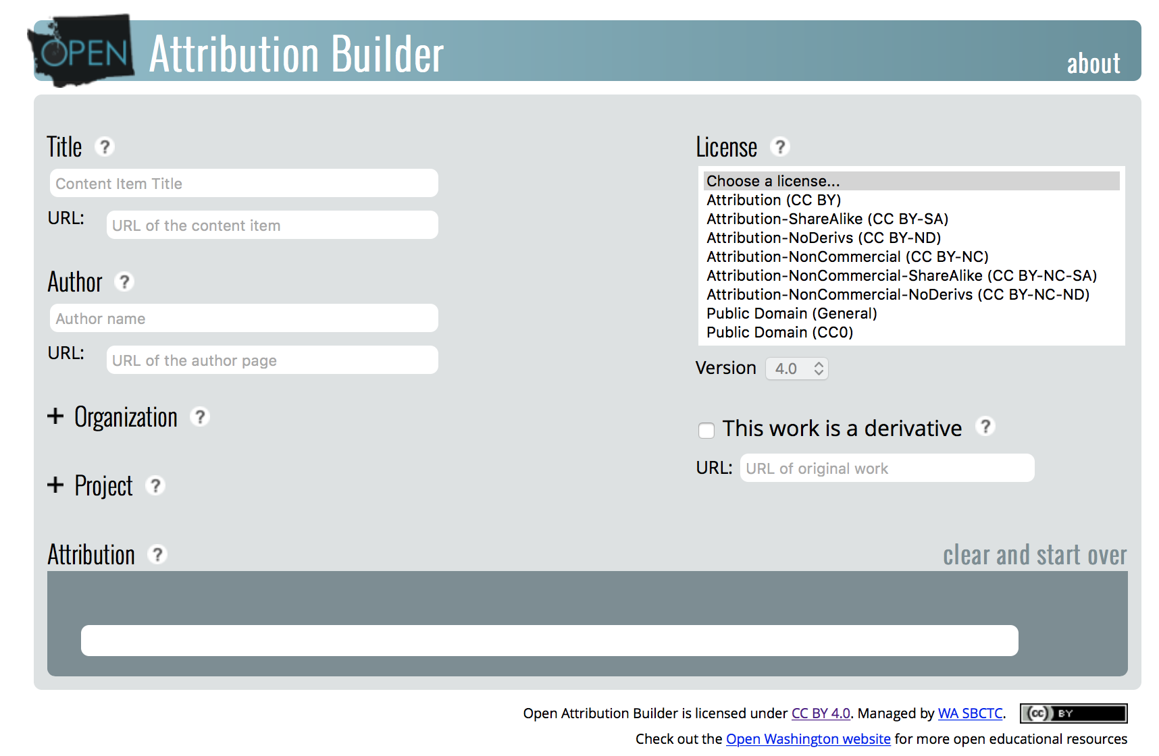
Open Attribution Builder

Slide 14
CC-BY Licensing
Applies to:
Only work that is developed by the grantee with the grant funds.

Slide 15
CC-BY Licensing
Does not apply to:
Pre-existing copyrighted materials licensed to, or purchased by the grantee from third parties, including modifications of such materials.
Works created without grant funds.

Slide 16
CC-BY Licensing
“This license allows subsequent users to copy, distribute, transmit and adapt the copyrighted Work and requires such users to attribute the Work in the manner specified by the grantee. Notice of the license shall be affixed to the Work. For general information on CC BY, please visit http://creativecommons.org/licenses/by/4.0.”

Slide 17
CC-BY Licensing
“From a public policy perspective, the Department is a better steward of public funds by giving the public access to those things created using public funds, and ensuring that these products have as wide spread a use as possible.”

Slide 18
DOL Disclaimer Statement
1.2 Disclaimer of the U.S. Department of Labor as the Funder of the Project
If applicable, the following needs to be on all products developed in whole or in part with grant funds,
“This workforce product was funded by a grant awarded by the U.S. Department of Labor’s Employment and Training Administration. The product was created by the grantee and does not necessarily reflect the official position of the U.S. Department of Labor. The U.S. Department of Labor makes no guarantees, warranties, or assurances of any kind, express or implied, with respect to such information, including any information on linked sites and including, but not limited to, accuracy of the information or its completeness, timeliness, usefulness, adequacy, continued availability, or ownership.”
Retrieved 12/5/2014 from: http://www.doleta.gov/grants/pdf/SGA-DFA-PY-13-10.pdf. pg. 38.

Slide 19
Accessibility
“All online and technology-enabled content and courses developed under this SGA must incorporate the principles of universal design (see http://www.cast.org/udl/) in order to ensure that they are readily accessible to qualified individuals with disabilities. The content and courses must be in full compliance with the Americans with Disabilities Act and Sections 504 and 508 of the Rehabilitation Act of 1973, as amended, and the Web Content Accessibility Guidelines 2.0, Level AA (http://www.w3.org/TR/WCAG/).”
Retrieved 12/5/2014 from: http://www.doleta.gov/grants/pdf/SGA-DFA-PY-13-10.pdf. pg. 35.

Slide 20
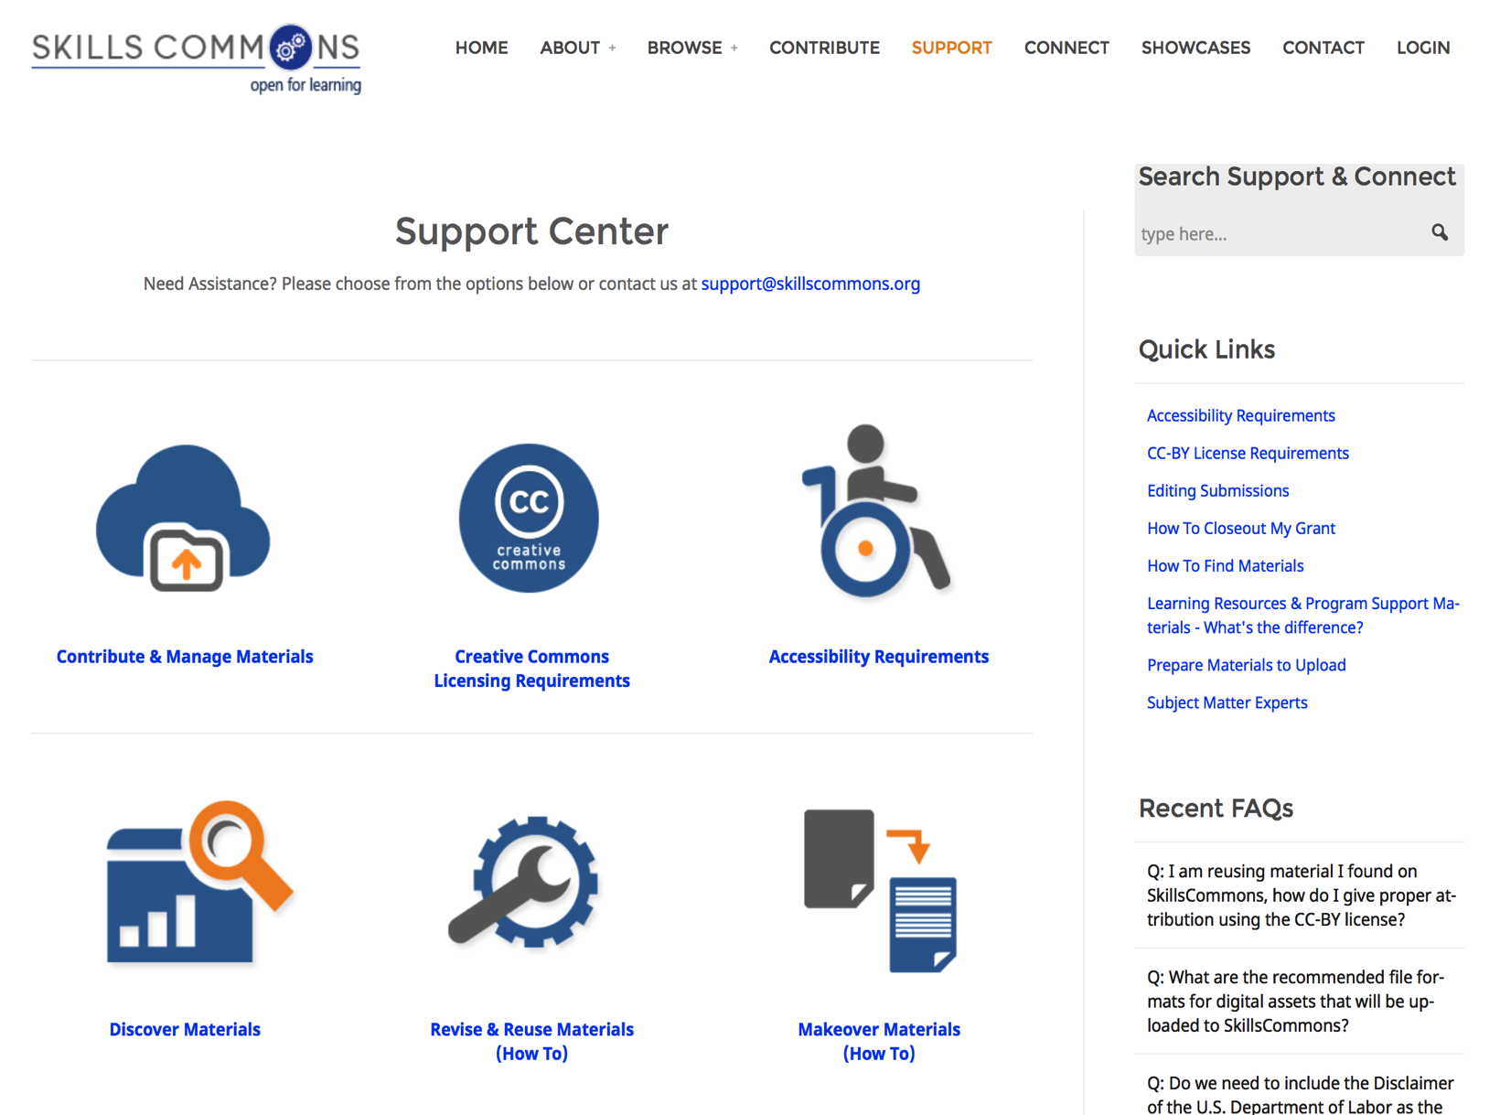
Support Center Resources

Slide 21
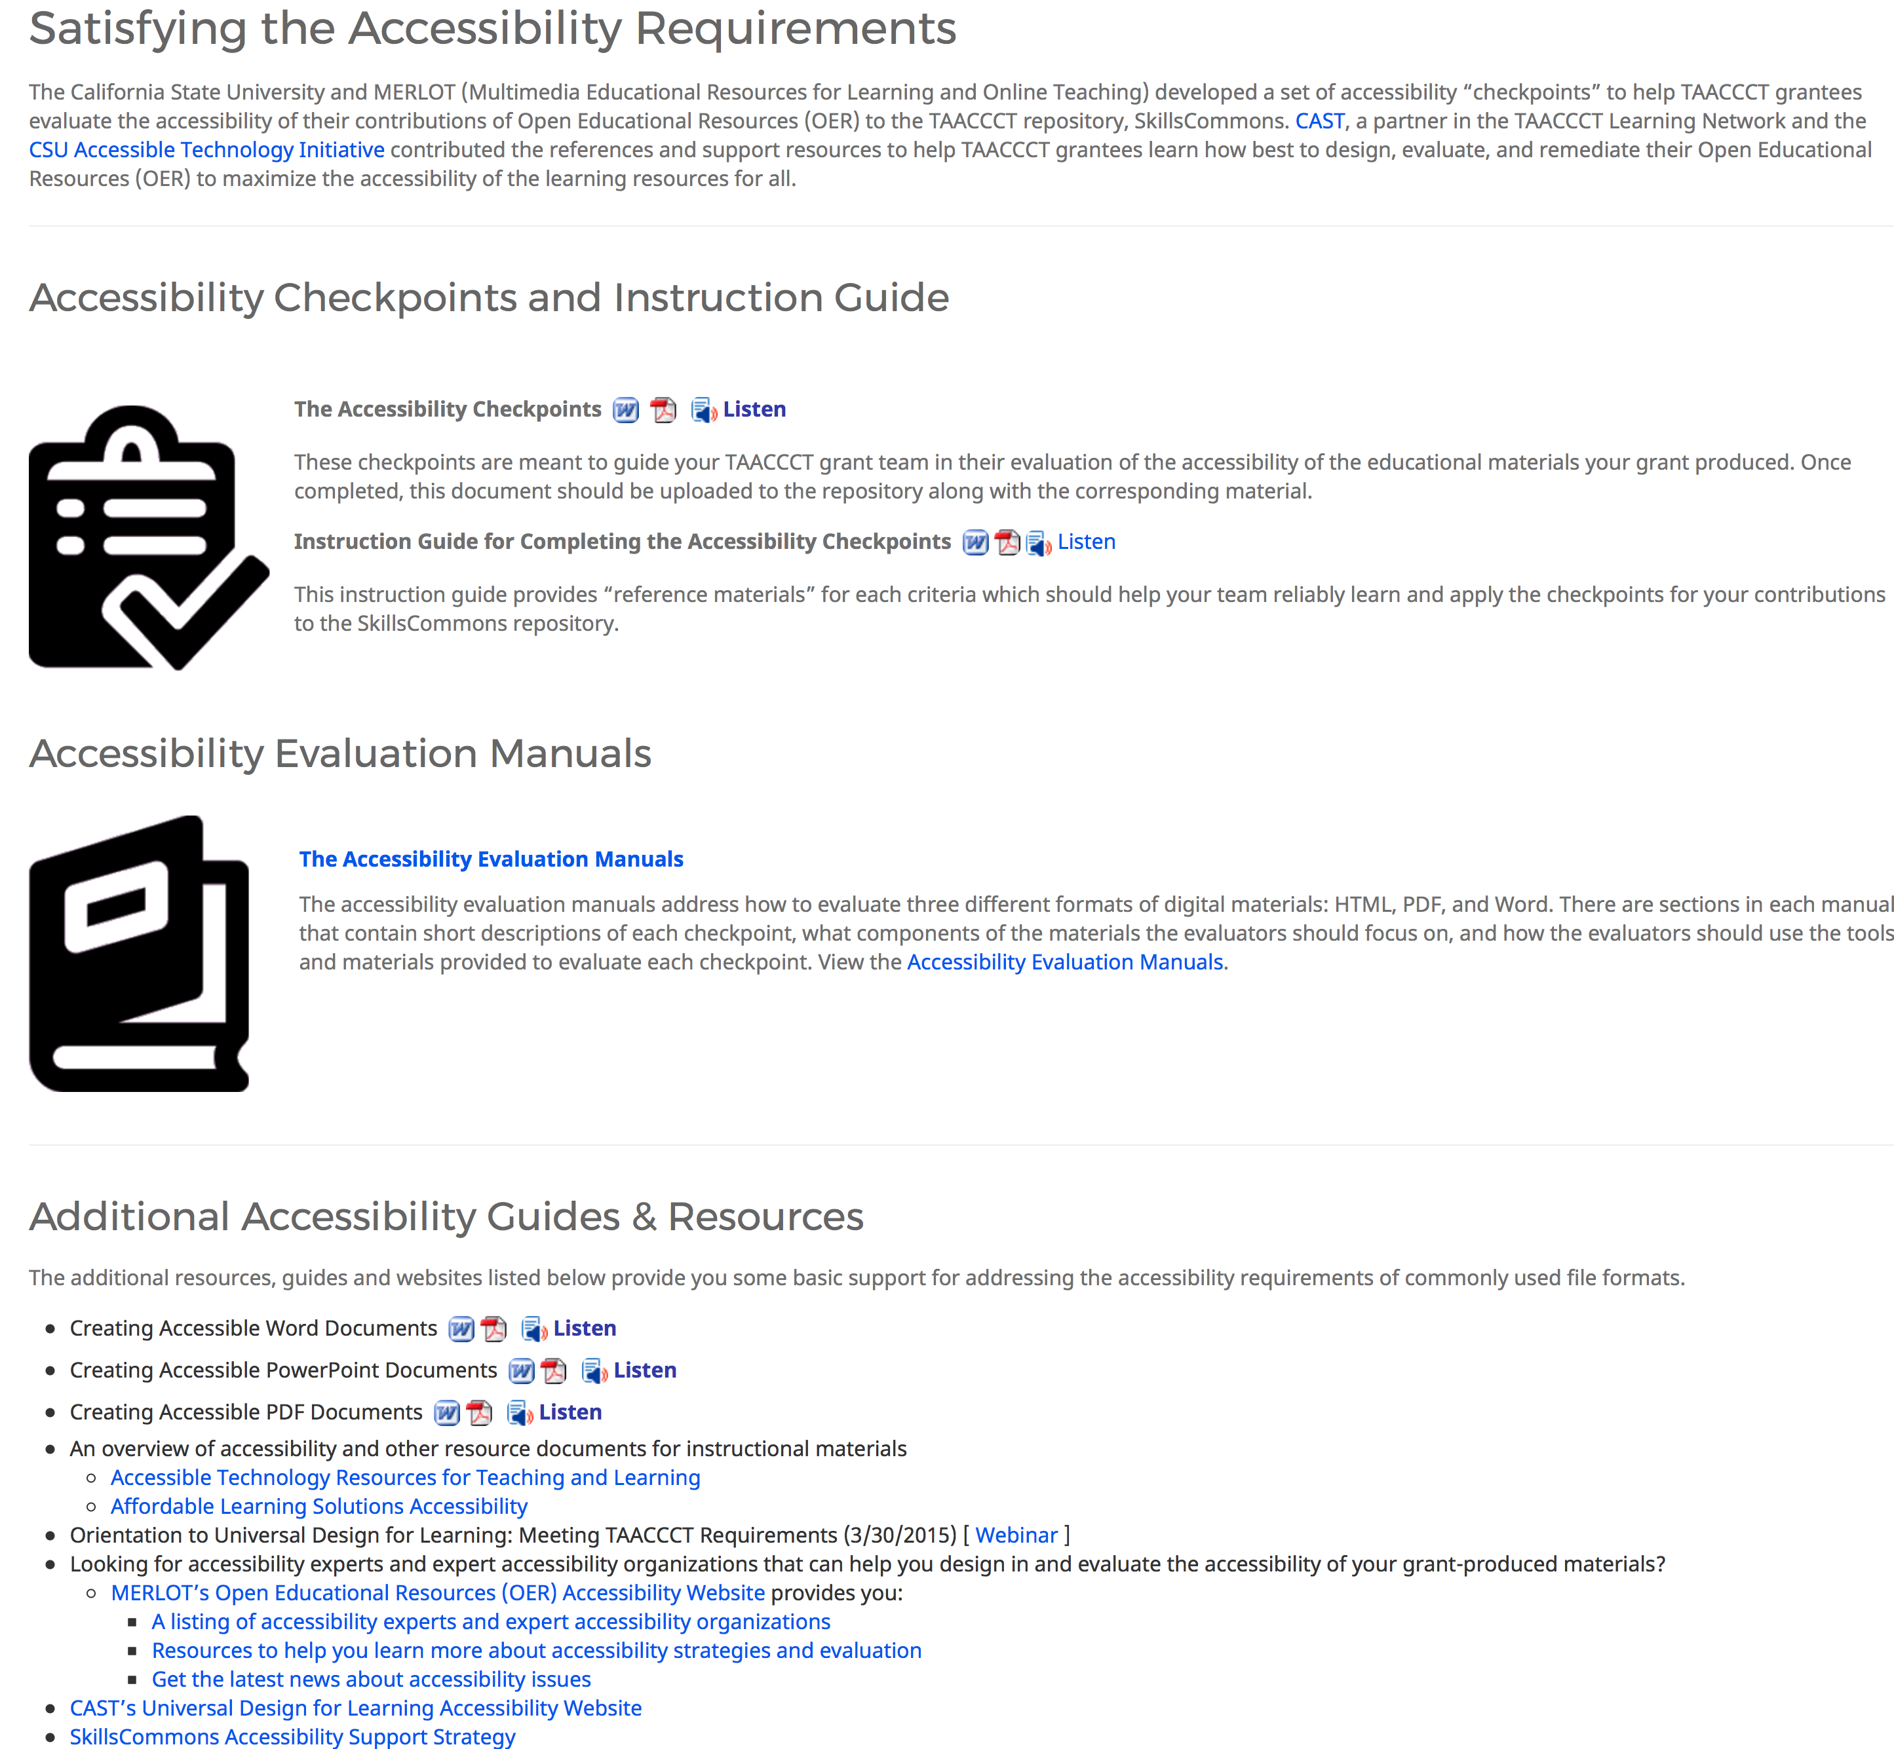
Support Center: Help With Accessibility

Slide 22
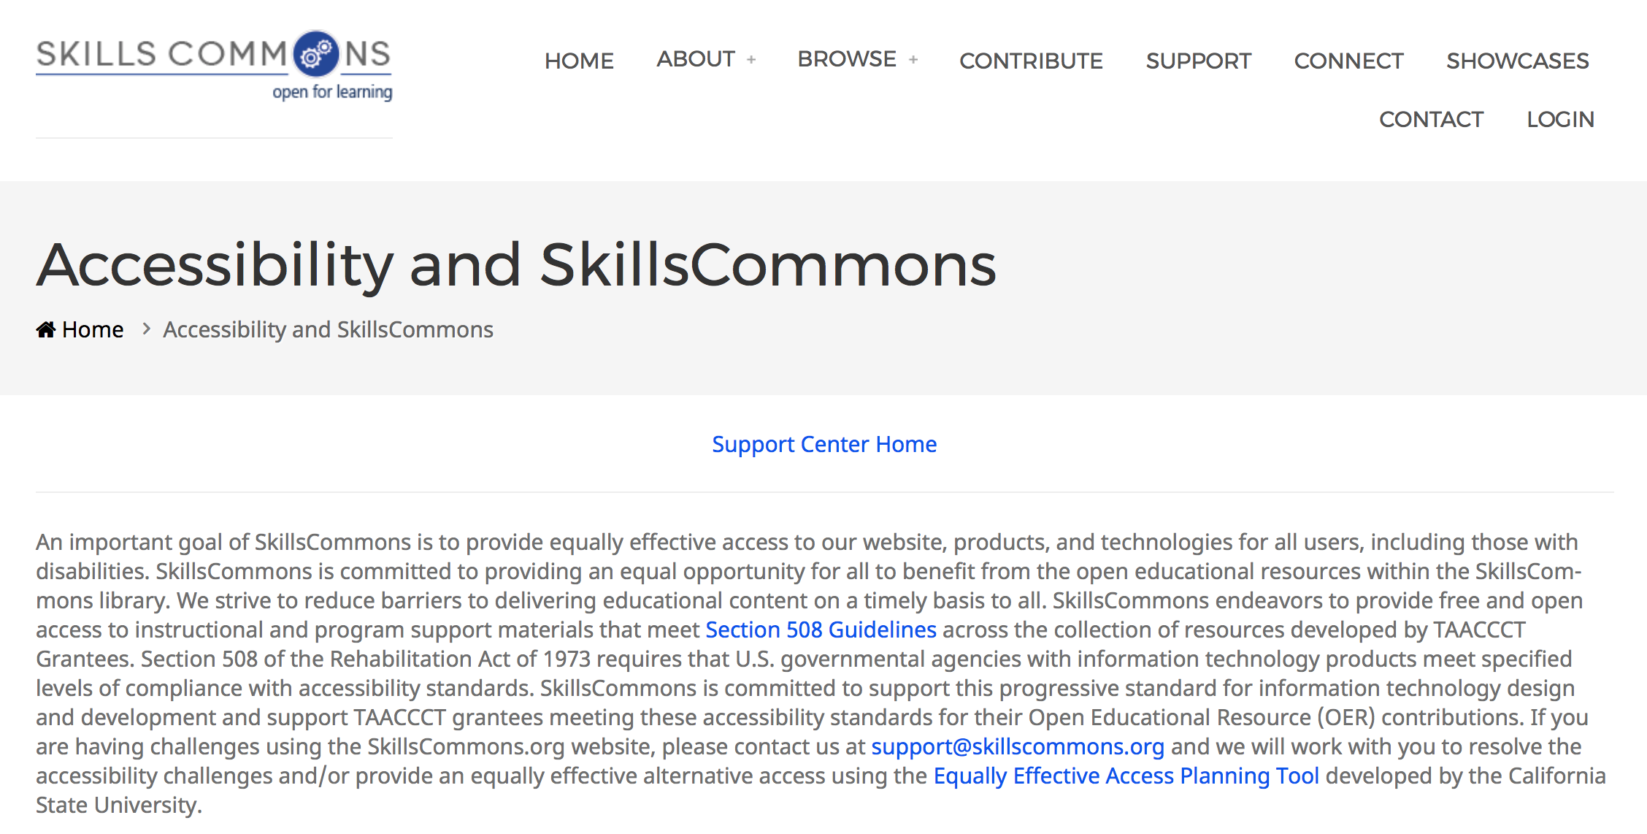
Support Center: Help With Accessibility

Slide 23
Support Center: Help With Accessibility
To Summarize: Suggested Accessibility Strategy:
  Provide an statement of support for accessibility, describe the steps taken to improve accessibility, and explain how you will respond to anyone who needs support to make your materials accessible to them.
  Use a rubric to guide your accessibility evaluation of your materials
  Document and upload your evaluation.
SkillsCommons has created a VOLUNTARY procedure which provides a simple template summarizing the methods you used to improve accessibility and a statement verifying you have satisfied the SGA requirements on accessibility.

Slide 24
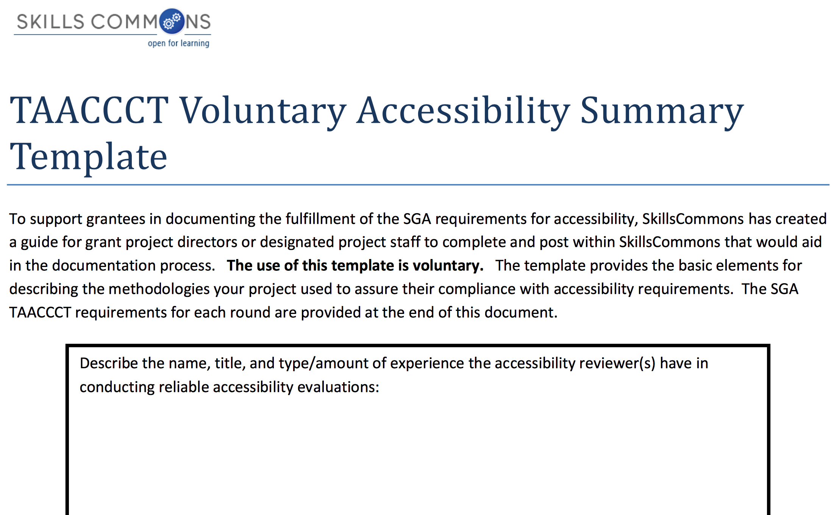
Support Center: Help With Accessibility

Slide 25
Subject Matter Expert Review
1.4 Review of Grant Deliverables - SME Report
“Grantees will be required to identify third-party subject matter experts to conduct reviews of the deliverables produced through the grant. Applicants should allot funds in their budgets for the independent review of their deliverables by appropriate subject matter experts. Subject matter experts are individuals with demonstrated experience in developing and/or implementing similar deliverables. These experts could include applicants’ peers, such as representatives from neighboring education and training providers. The applicant must provide the Department with the results of the review and the qualifications of the reviewer(s) at the time the deliverables are provided to the Department.”
Retrieved 12/5/2014 from: http://www.doleta.gov/grants/pdf/SGA-DFA-
PY-13-10.pdf. pg. 35.

Slide 26
Quality Assurance
TAACCCT wants to provide users CONFIDENCE that the materials produced by grantees are of high quality and aligned with skills and knowledge for the jobs available
  Documents describing how Subject Matter Experts in industry reviewed and approved your learning materials are essential.
  Universal Design for Learning (UDL)
  Quality designs for online and hybrid instruction

Slide 27
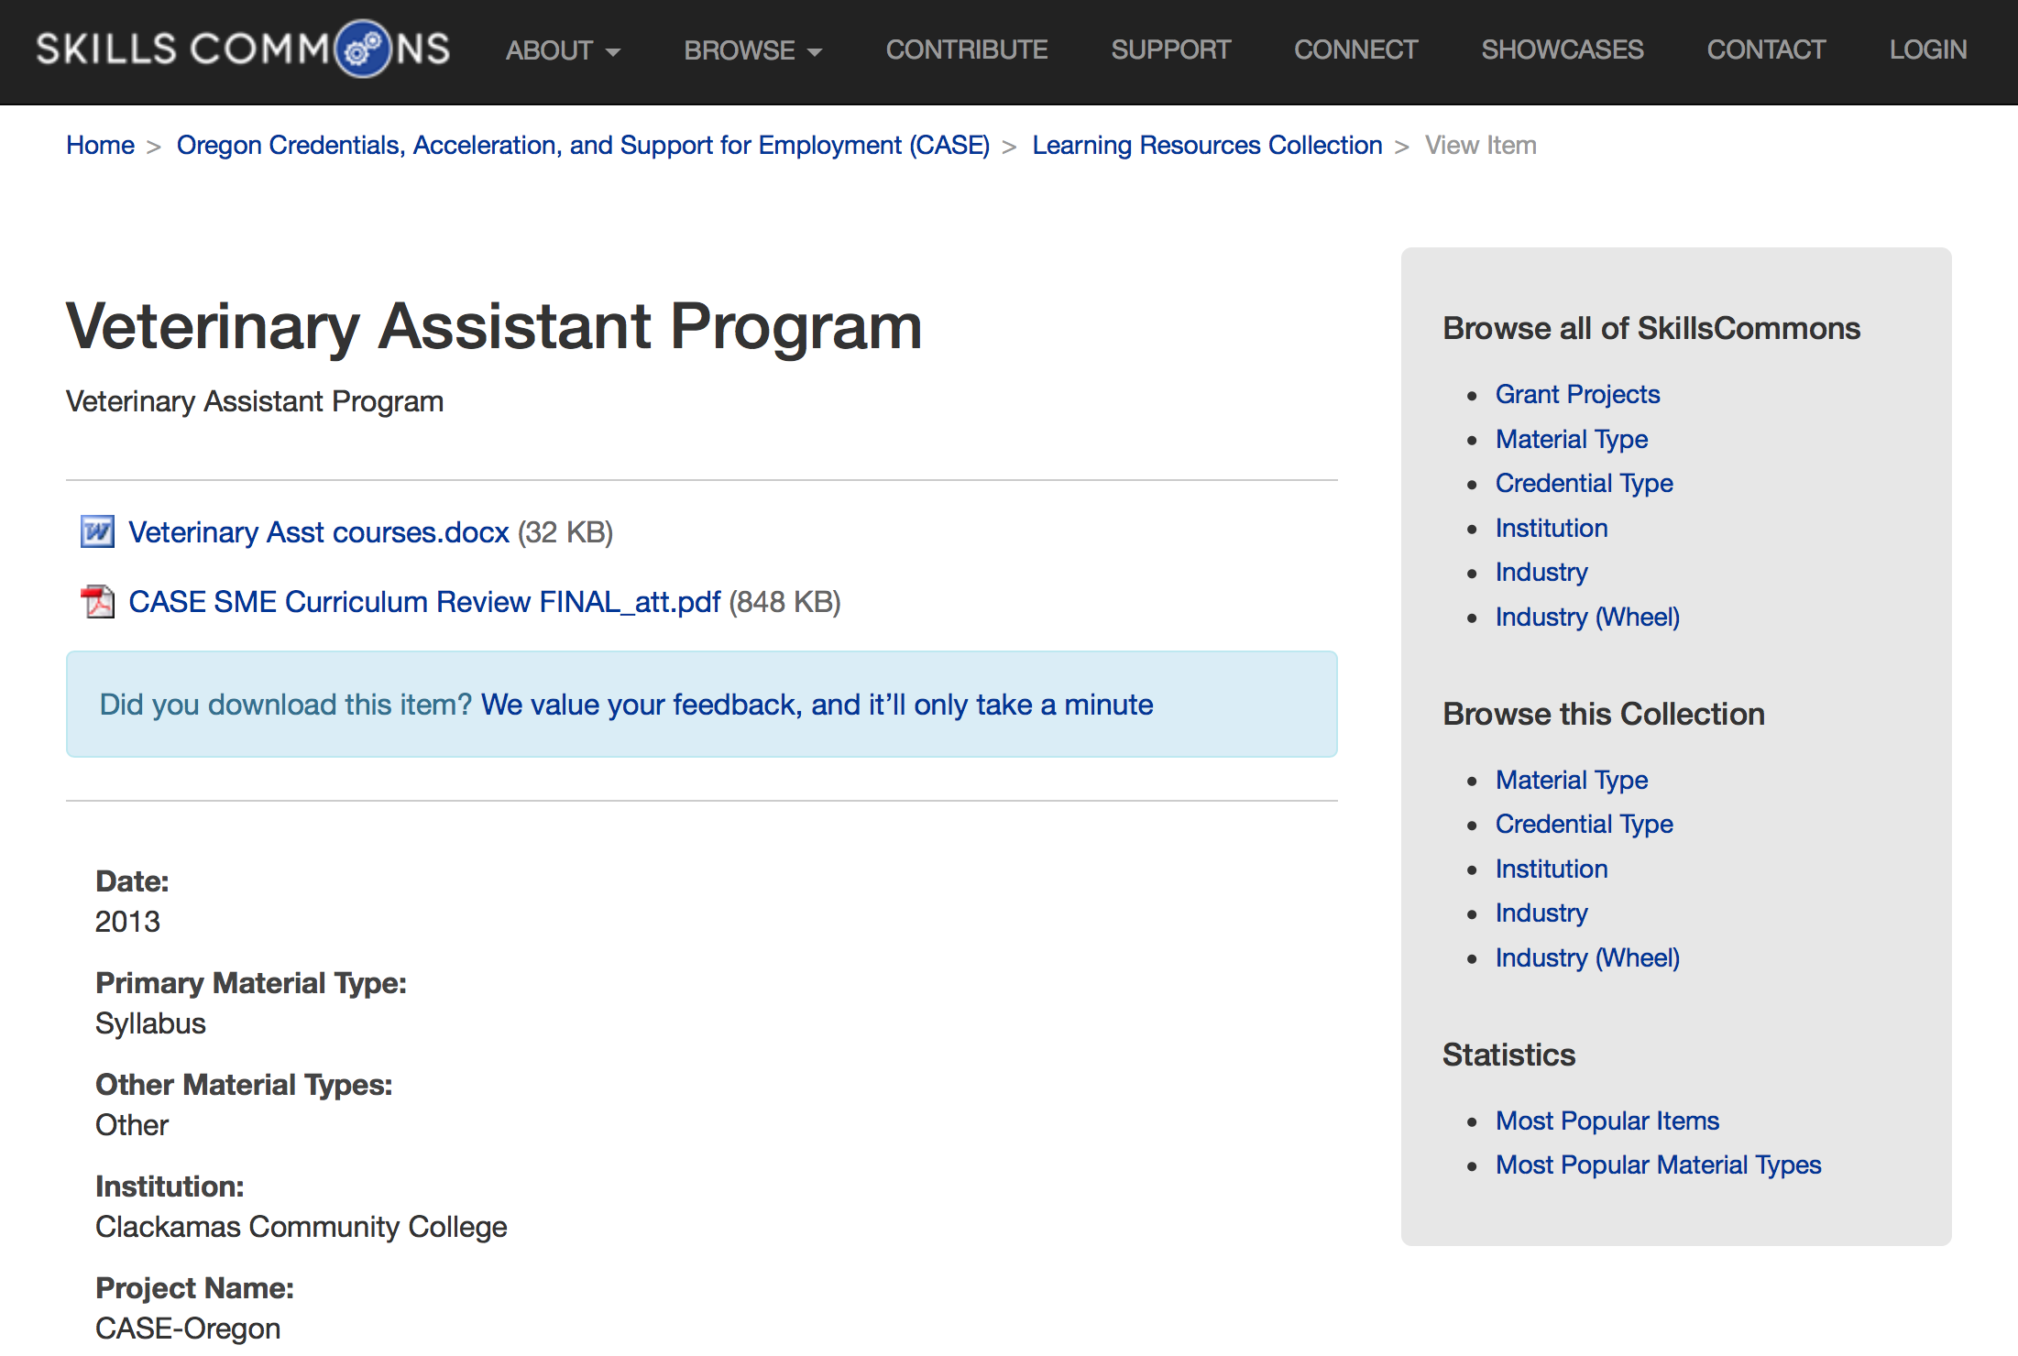
Sample SME Report

Slide 28
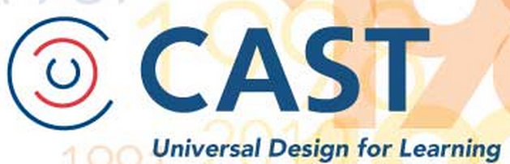
UDL Implementation
UDL GUIDES ALL ELEMENTS OF CURRICULUM
Goals
Materials
Methods
Assessment
udloncampus@cast.org

Slide 29
Support Center: Help With Quality Assurance

Slide 30

Quality Assurance for Online & Hybrid Course

Slide 31

Questions and Answers
Questions?

Slide 32
With good planning, It’s easy
UPLOADING

Slide 33
Uploading is like moving to a new home
Moving | Uploading | Comments & Advice
Find Your New Home | Get an Account from SkillsCommons | Any Questions??? Ask support@skillscommons.org
Clean out the things you don’t want to bring to your new home | Do “Spring Cleaning” on the materials you might have already uploaded – improve descriptions and repack | Deleting some “test materials” and starting fresh is best. Industry partner and descriptions are ones we believe need the most improvement
Packing up your belongings- not too big and not too small. Label your boxes well | Organizing your grant deliverables to be packaged for uploading. Add accurate and detailed descriptions in metadata | Think about how other people will want to use your materials. A zipped 500MB file will be too big for others to download. Organize submissions into “usable” instructional packages
Movers transport your belongings | Your staff uploads the digital packages to SkillsCommons | Recommend 1 or a few people to upload the materials for reliability in the descriptions/submissions

Slide 34
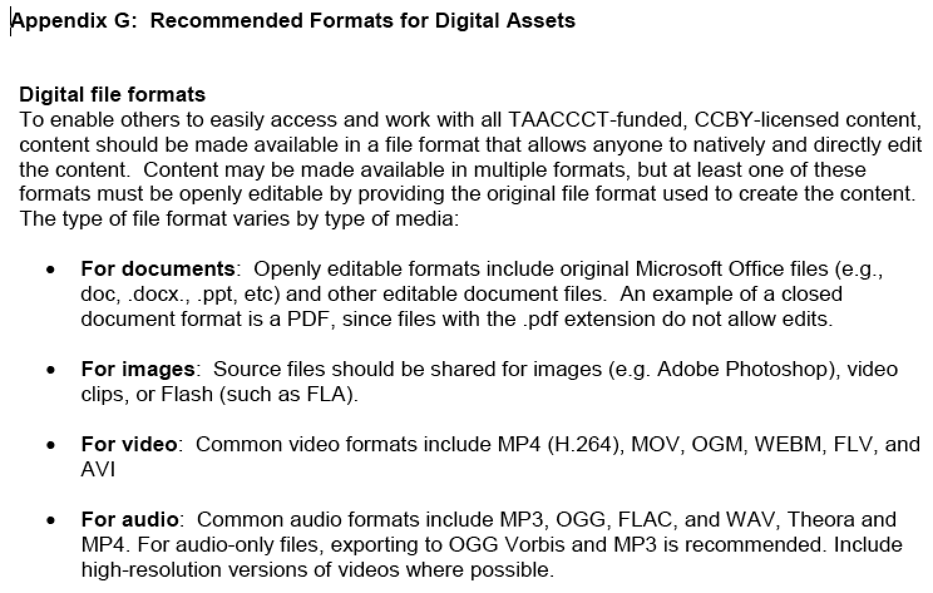
File Formats for Digital Assets
SGA

Slide 35
Demonstrating Uploading
http://skillscommons.org

Slide 36
“Share Your Screen”

Slide 37
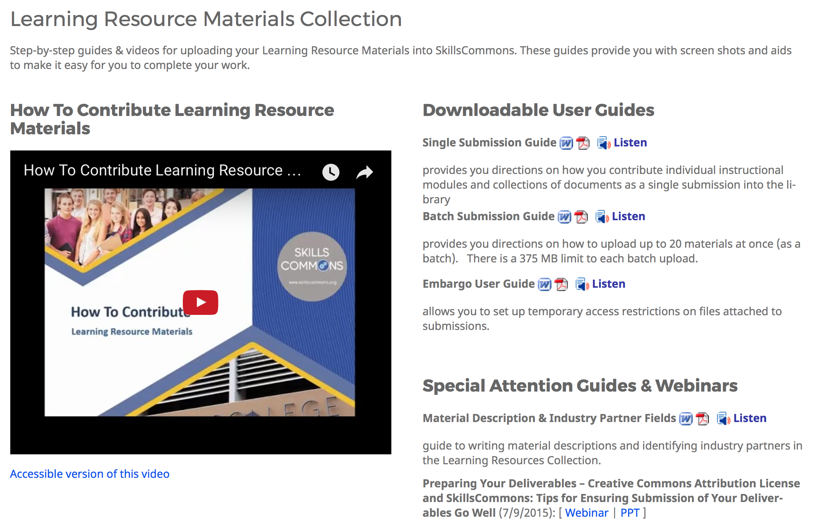
Support Center: Help with Uploading Process

Slide 38
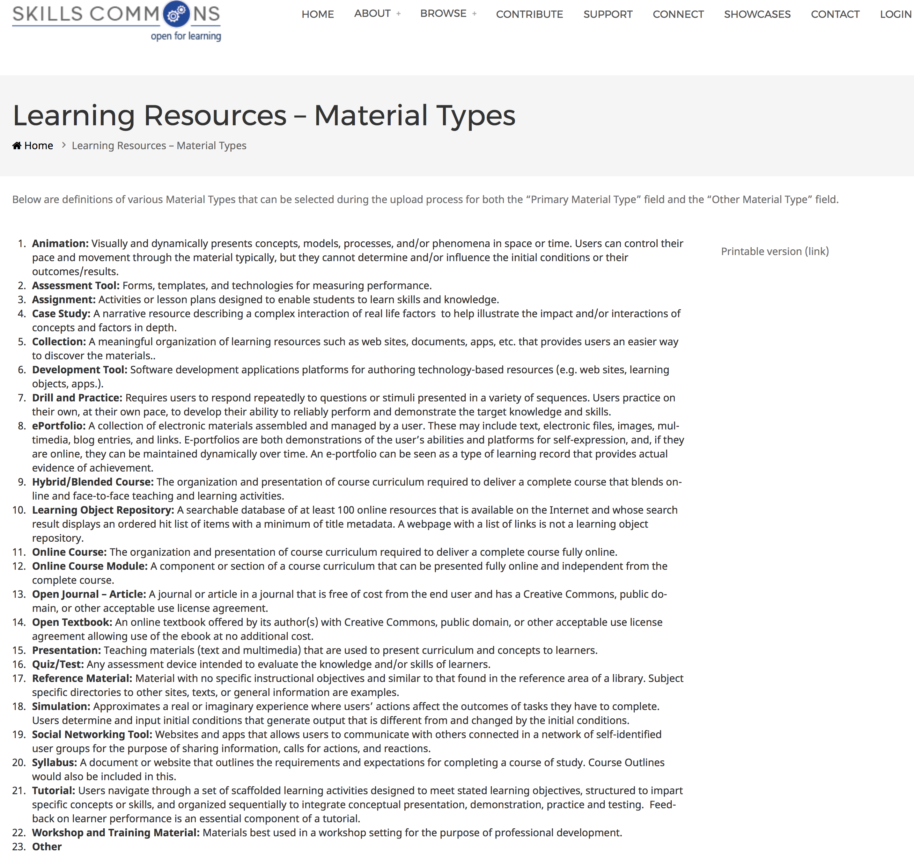
Material Type: Learning Resource Materials

Slide 39
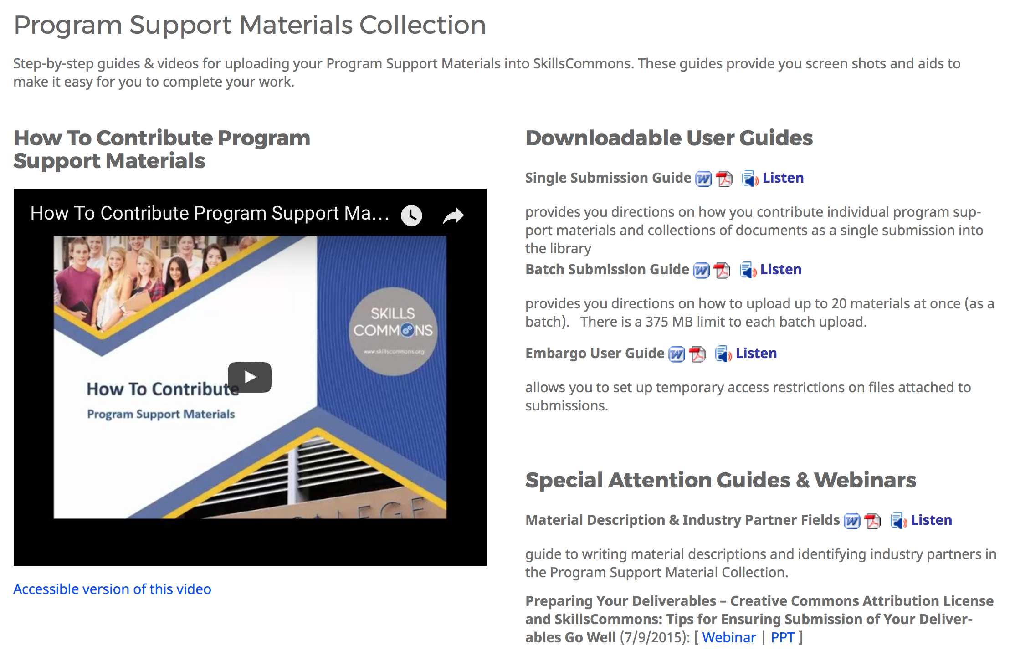
Support Center: Help with Uploading Process

Slide 40
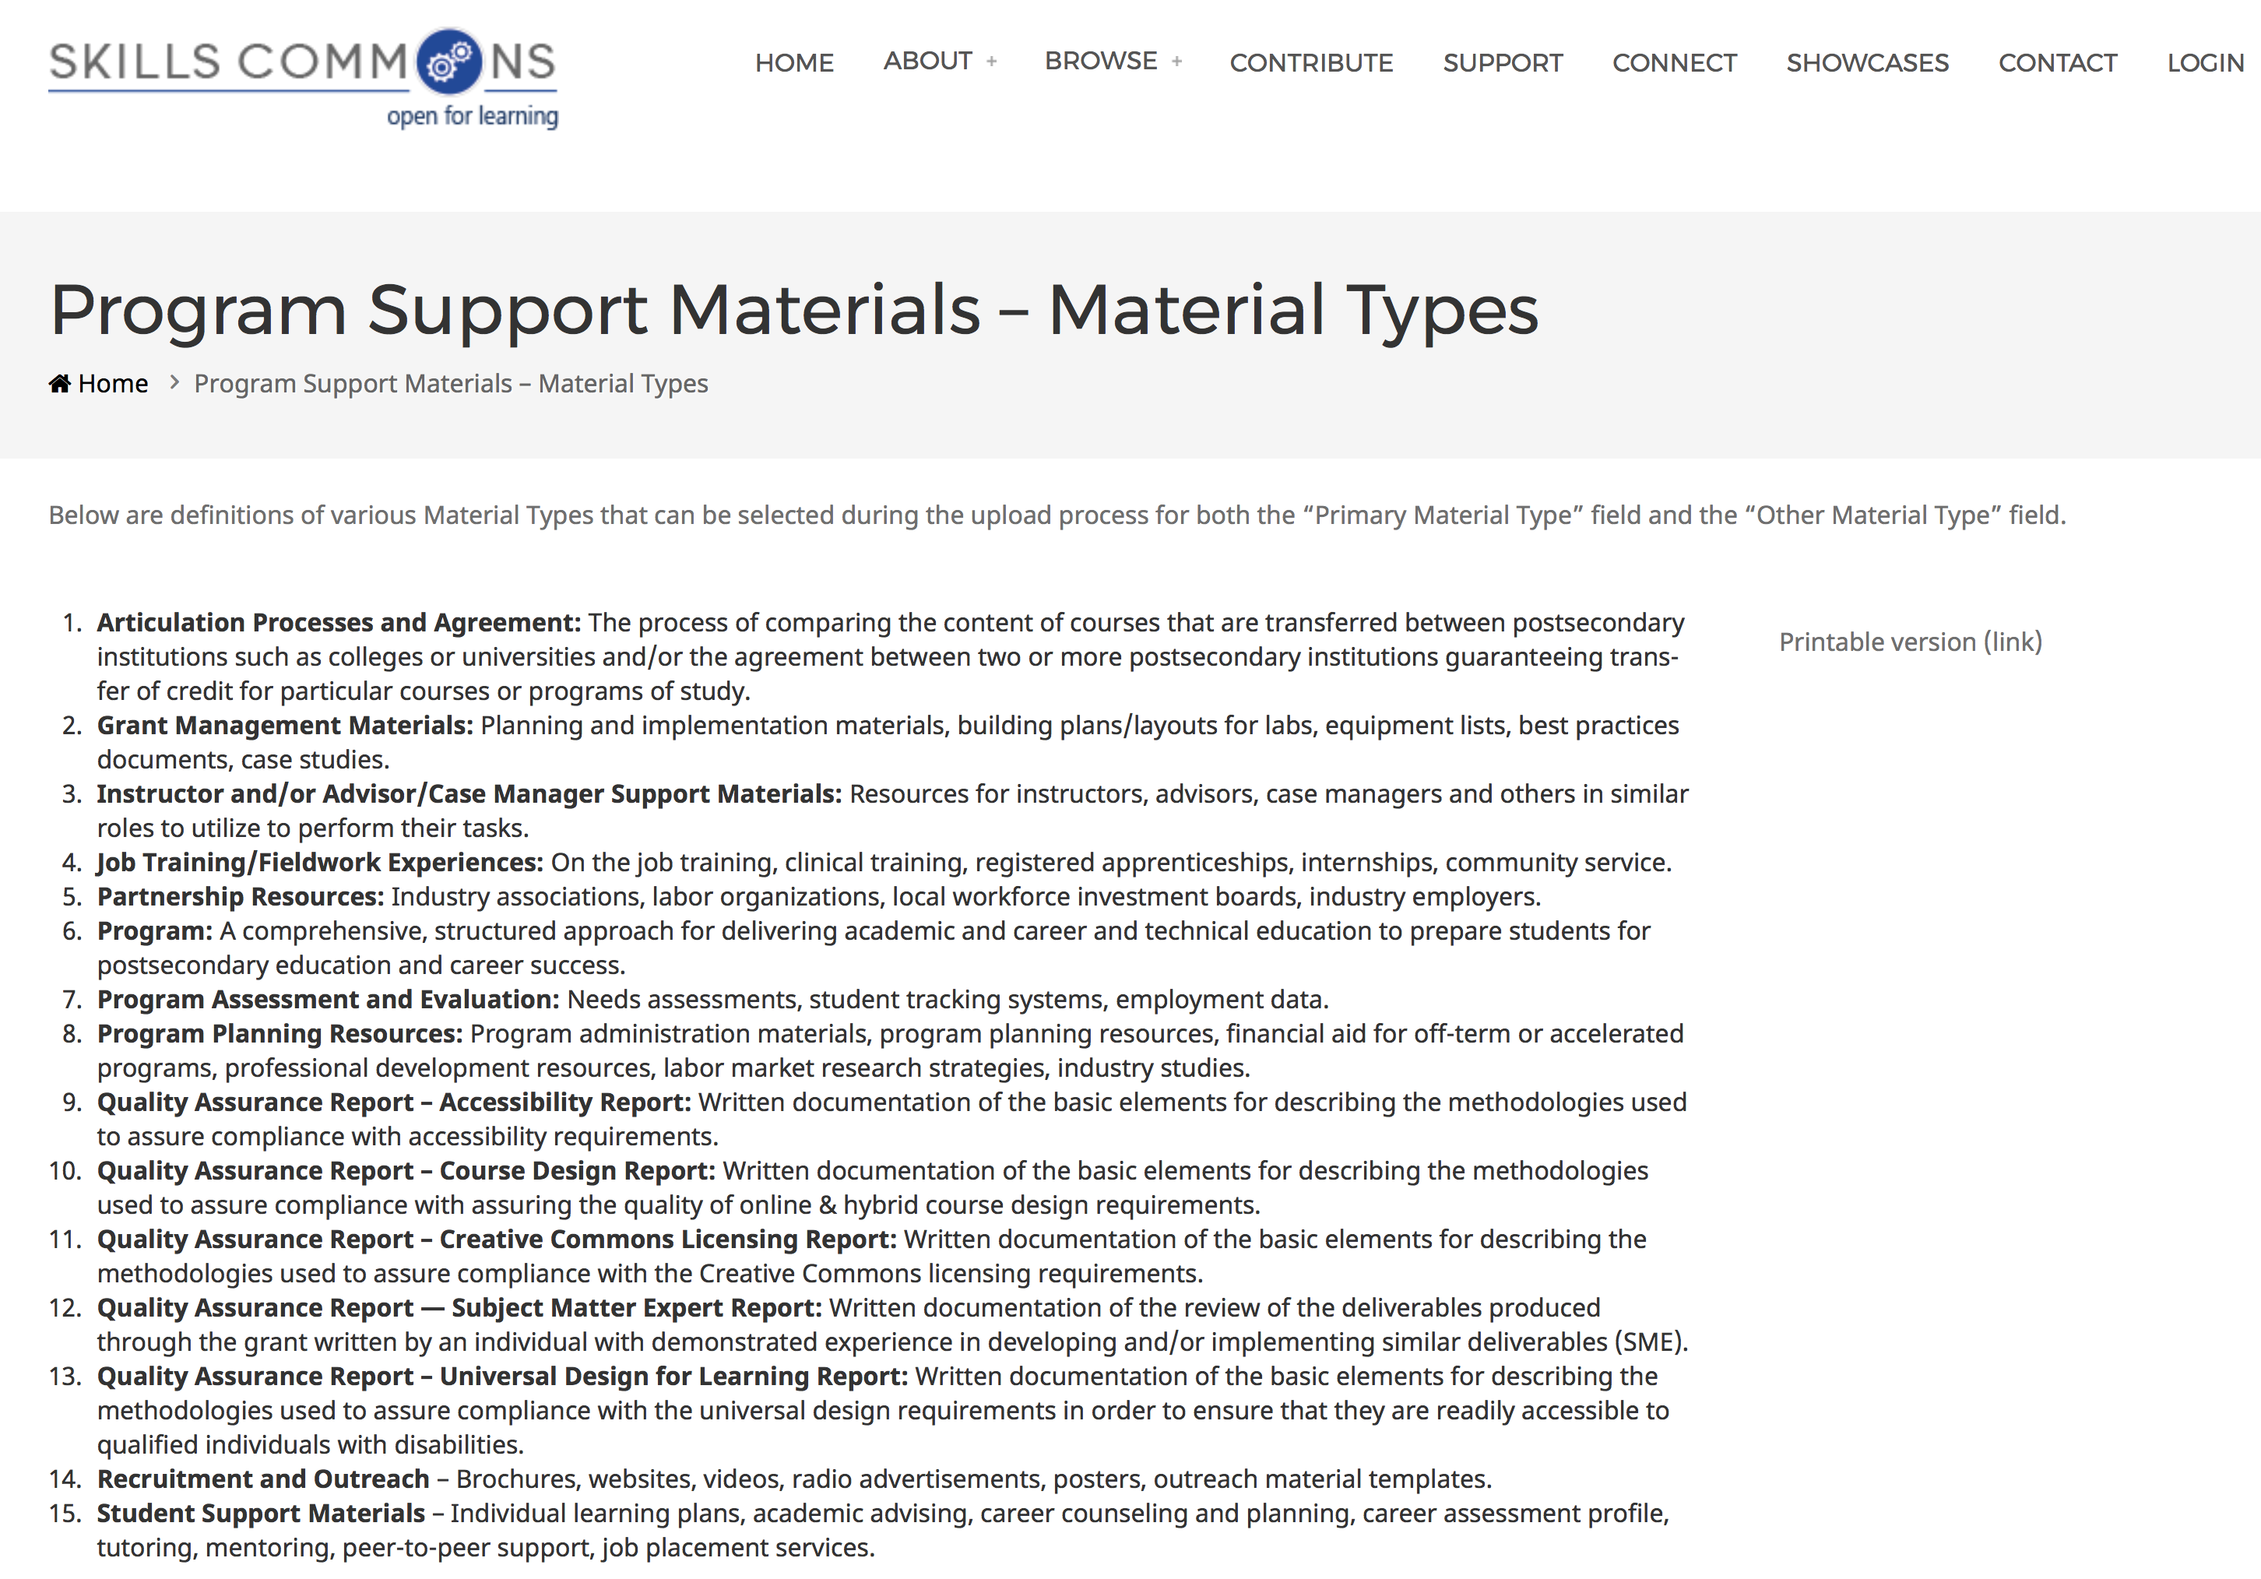
Material Type: Program Support Materials

Slide 41
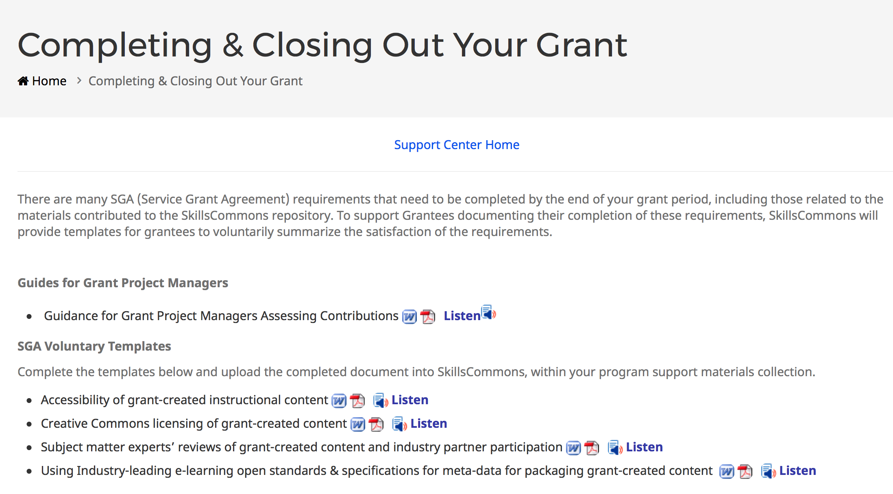
SGA Voluntary Templates

Slide 42
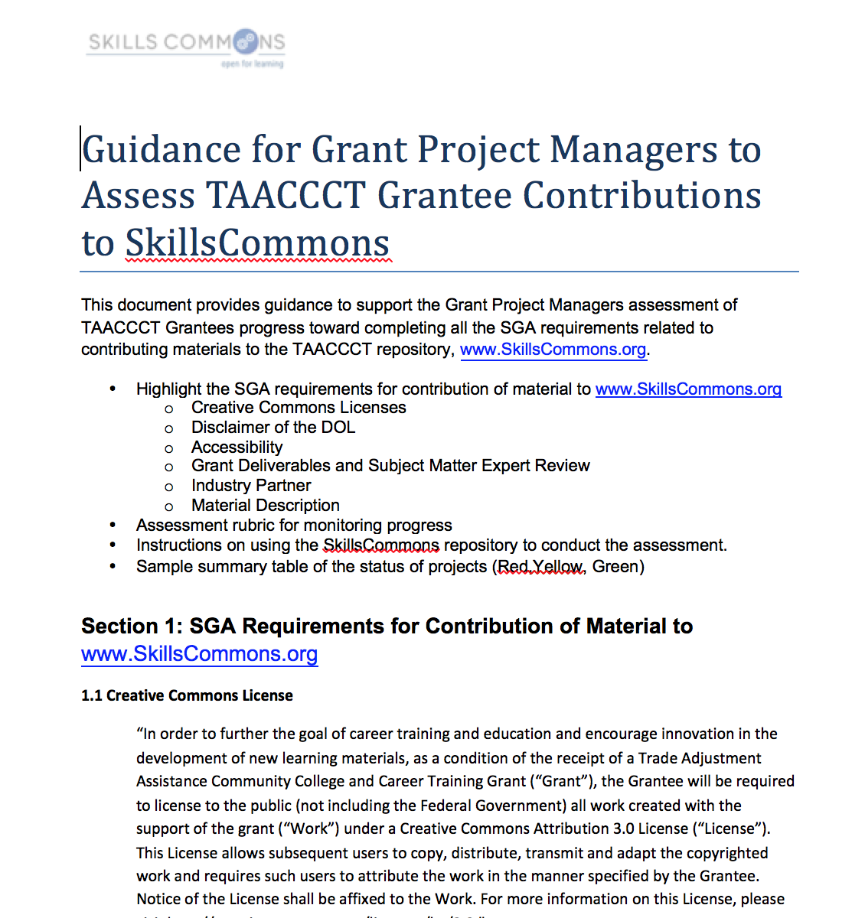
Guidance for Grant Project Managers to Assess TAACCCT Grantee Contributions

Slide 43
“Stop Screen Share”

Slide 44
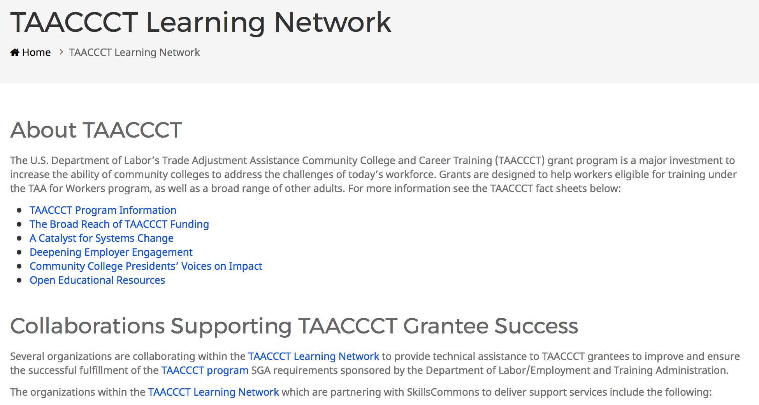

SkillsCommons Collaborations Supporting TAACCCT Grantee Success

Slide 45
Questions
Explore the support services available from Creative Commons & Skills Commons
  SkillsCommons.org Support Services Center:
  http://support.taaccct.org/home/getting-started/
Ask questions:
Skills Commons support@skillscommons.org

